Slide 1
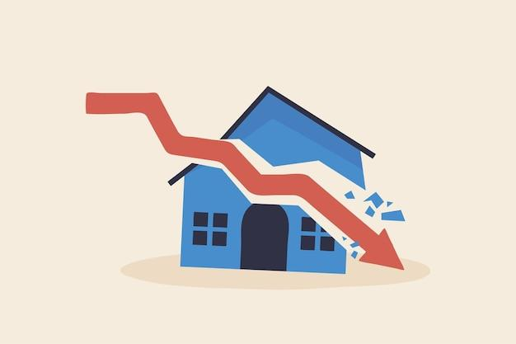
Housing Crash 2008

Slide 2
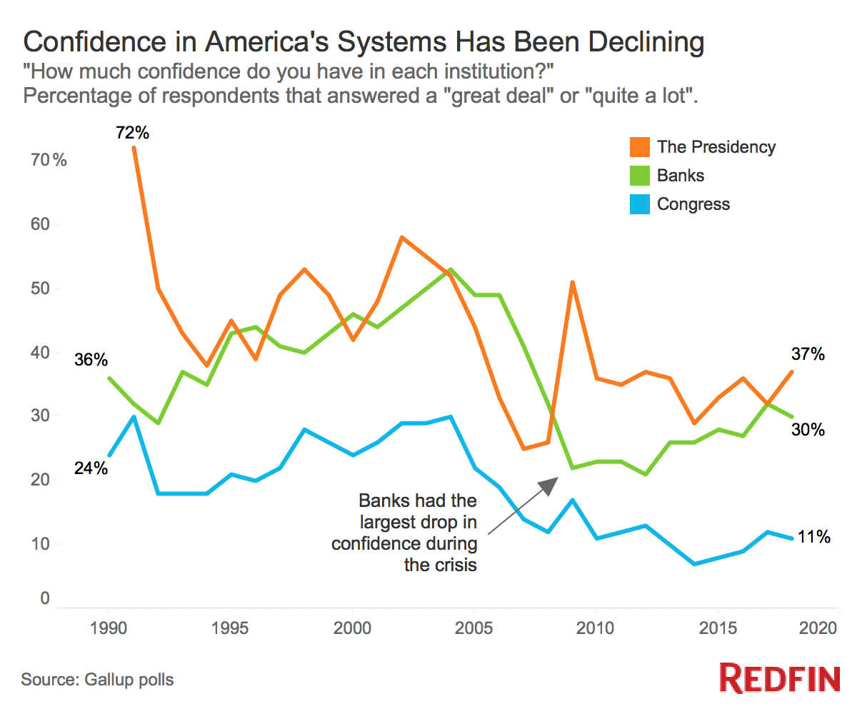

Slide 3
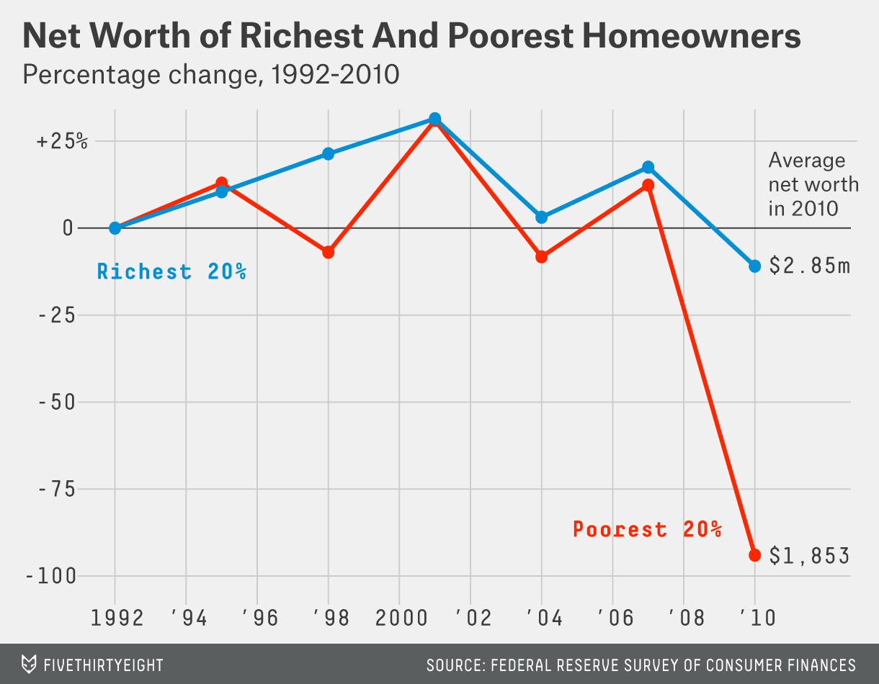

Slide 4
Reasons for the Crisis
Inability to pay the mortgage
Fraud in Rating Agencies
Overbuilding during the boom period
Predatory lending - unfair and deceptive

Slide 5
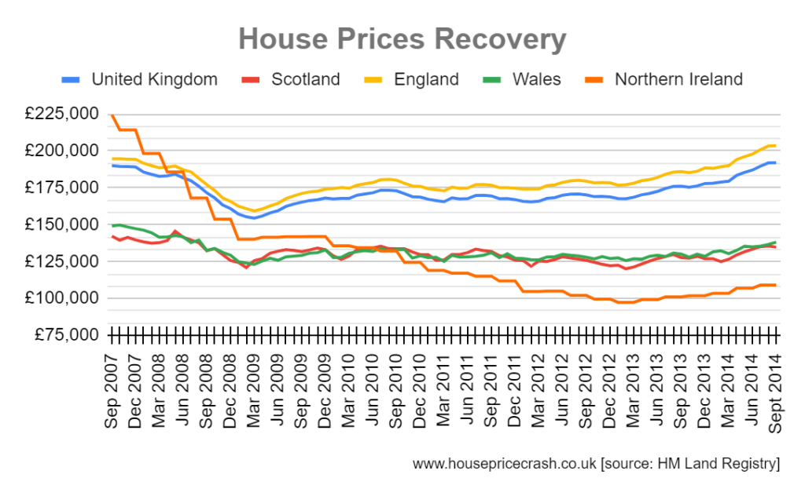

Slide 6
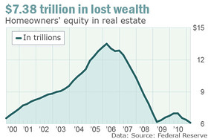
How the bubble destroyed the middle-class

Slide 7
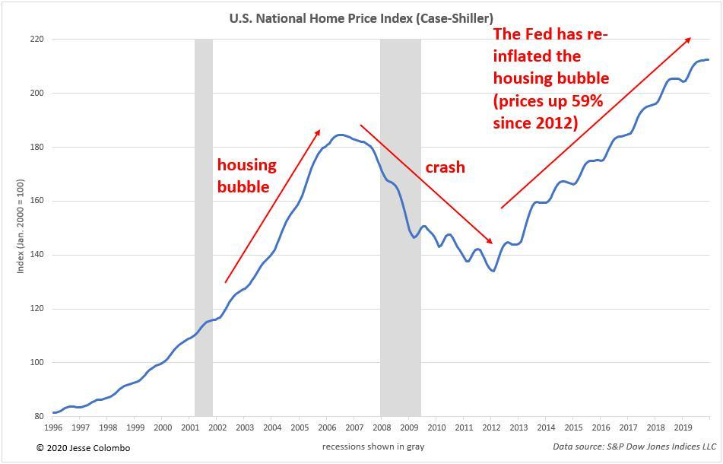

Slide 8
Thank you
Student ID : 201923250

